Slide 1


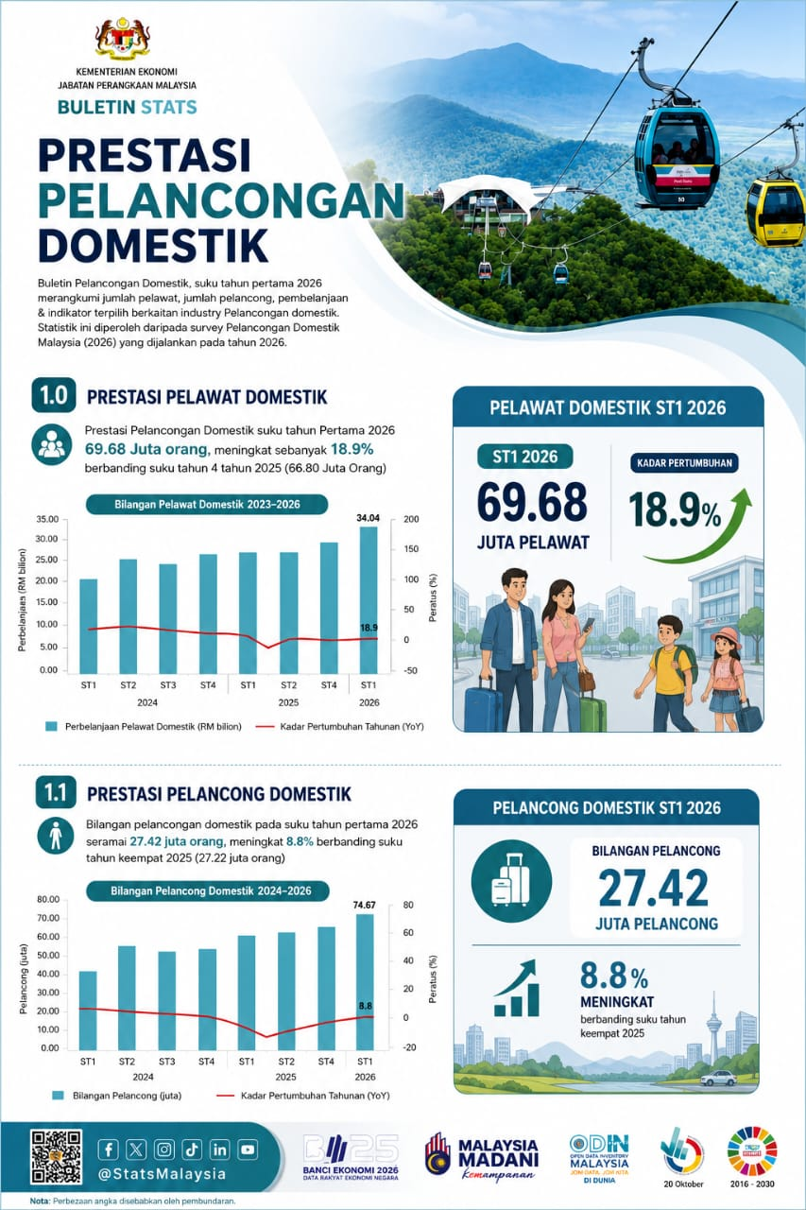
PRESTASI
PELANCONGAN
DOMESTIK
Pengenalan
Buletin Pelancongan Domestik suku tahun pertama 2026 menyediakan Gambaran keseluruhan mengenai bilangan pelawat, jumlah pelancong, perbelanjaan dan indikator terpilih berkaitan industri pelancongan domestik. Statistik ini diperoleh daripada Survei Pelancongan Domestik Malaysia yang dijalankan pada tahun 2026.
74.7
7.2%
1.0 PRESTASI PELAWAT DOMESTIK
Pelawat domestik suku tahun pertama 2026 mencatatkan seramai 74.7 juta pelawat, meningkat sebanyak 7.2 peratus berbanding suku tahun pertama 2025 (69.7 juta pelawat). Perbandingan dengan suku tahun sebelumnya ia mencatatkan peningkatan sebanyak 0.9 peratus.
Bilangan Pelawat Domestik mengikut Suku Tahun, 2023-2026

Slide 2
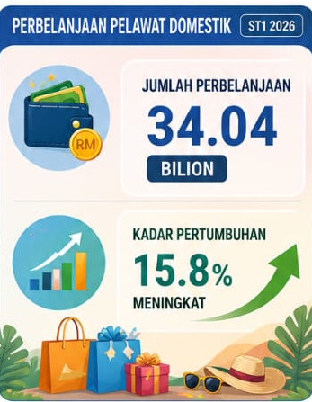
2.0 PRESTASI PELANCONG DOMESTIK
Bilangan pelancong domestik pada suku tahun pertama 2026 merekodkan sebanyak 27.4 juta pelancong, meningkat 8.8 peratus berbanding suku tahun pertama 2025 (25.2 juta orang). Sementara itu, pelancong domestik meningkat 0.7 peratus berbanding suku tahun sebelumnya.
Bilangan Pelancong Domestik
Mengikut Suku Tahun, 2023-2026
27.4
8.8
3.0 PERBELANJAAN PELANCONGAN DOMESTIK
Perbelanjaan pelancongan domestik pada suku tahun pertama 2026 mencatatkan sebanyak RM34.0 bilion, meningkat 15.8 peratus berbanding suku tahun yang sama bagi tahun sebelumnya (RM29.4 bilion). Sementara itu, perbelanjaan pelancongan domestik meningkat 4.5 peratus berbanding suku tahun keempat 2025.
Perbelanjaan Pelancongan Domestik
mengikut Suku Tahun, 2023-2026
RM34.0
15.8

Slide 3

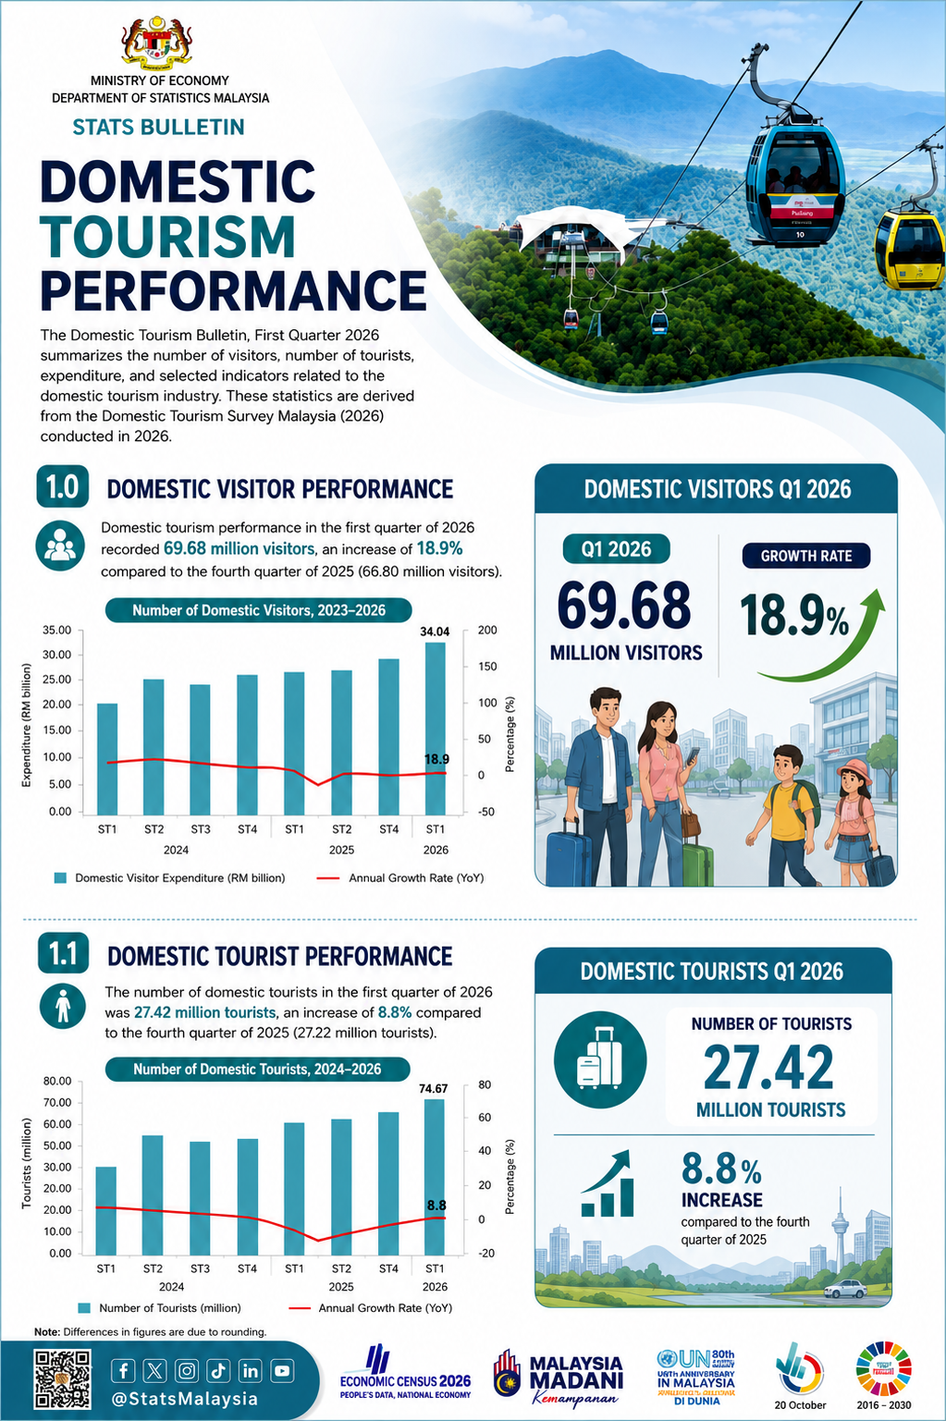
DOMESTIC TOURISM PERFORMANCE
Introduction
The Domestic Tourism Bulletin for the first quarter of 2026 provides an overview of the number of visitors, tourist arrivals, tourism expenditure, and selected indicators associated with the domestic tourism industry. The statistics presented are based on data collected through the Domestic Tourism Survey conducted during the year 2026
74.7
7.2%
1.0 PERFORMANCE OF DOMESTIC VISITORS
Domestic visitors in the first quarter of 2026 recorded 74.7 million visitors, representing an increase of 7.2 per cent compared to the first quarter of the previous year. Comparison to the previous quarter also shows an increase of 0.9 per cent.
Number of Domestic Visitors by Quarters, 2023-2026

Slide 4
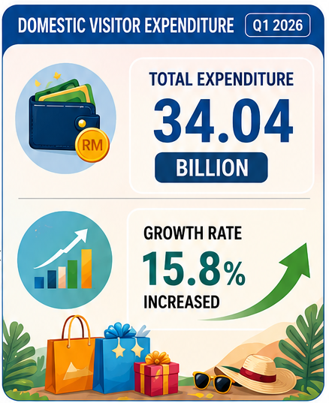
2.0 PERFORMANCE OF DOMESTIC TOURIST
Number of domestic tourist for the first quarter of 2026 were recorded 27.4 million tourists, reflecting a 8.8 per cent increase compared to 25.2 million tourists recorded in the first quarter of 2025. Meanwhile, domestic tourist increased 0.7 per cent as against to the previous quarter.
Number of Domestic Tourist by Quarters, 2023-2026
27.4
8.8%
3.0 EXPENDITURE OF DOMESTIC TOURISM
Domestic tourism expenditure in the first quarter of 2026 recorded RM34.0 billion, an increase of 15.8 per cent compared to the same quarter of the previous year (RM29.4 billion). Meanwhile, domestic tourism expenditure increased 4.5 per cent, compared to the fourth quarter of 2025.
Domestic Tourism Expenditure
by Quarters, 2023-2026
RM34.0
15.8%

